Slide 1

Linux Lecture-3
www.corvit.com

Slide 2
Topics
Users, Groups, Permissions
Crontab
Text Editors, Other Essential tools
Backup Techniques
I/O Redirection
Partitions
www.corvit.com

Slide 3
Linux User Accounts
Each user on Linux has a separate account with a password.
User accounts can be members of user groups.
The root account is known as a super-user and is all powerful (like Administrator on Windows)
Typically we log into a Linux system and escalate our privileges to become a super-user using the sudo command (super-user do) – Like ”Run as Administrator” on Windows.
www.corvit.com
Notes:
https://linuxize.com/post/how-to-create-users-in-linux-using-the-useradd-command/

Slide 4
Linux User Accounts
Users have a defined home directory, typically something like /home/username – The tilda (~) character is used as an alias for a user’s home directory.
You can add new users using the useradd command: – $ useradd bob $ sudo adduser bob
And delete users using the userdel command: – $ userdel –r bob $ sudo deluser --remove-home bob
www.corvit.com

Slide 5
Linux User Groups
The following example shows how to create a new user named “bob” and set the login group to users
$ sudo useradd –g users bob
To verify the user’s GID, use the id command $ id –gn bob
To create a new group
$ sudo addgroup groupname
To to add user to the group $ sudo usermod -aG groupname username
To list groups against a user groups username
www.corvit.com

Slide 6
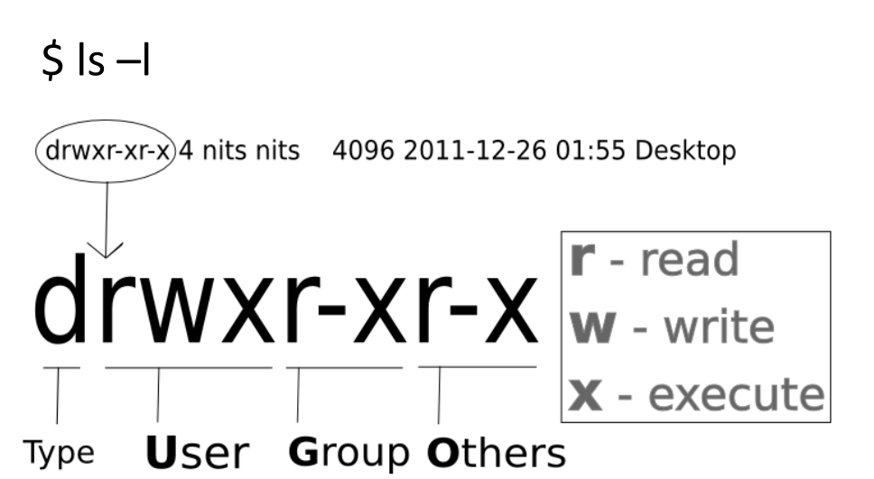
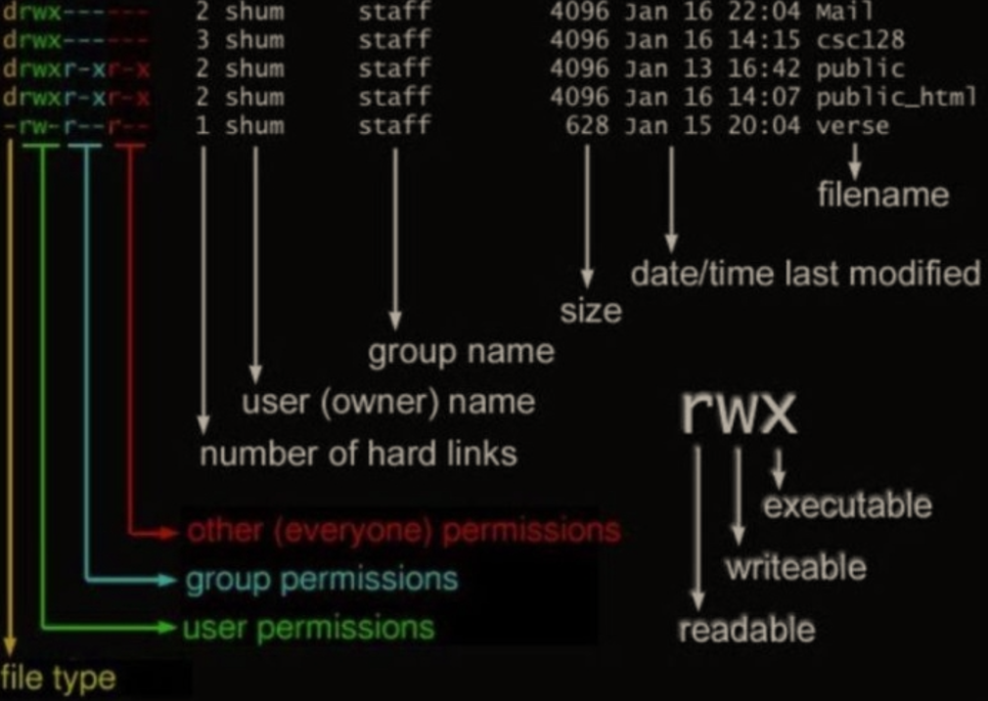
Linux File Permissions
www.corvit.com

Slide 7
Linux File Permissions
We use indicators to represent these values, and form short “permission statements” such as u+x where “u” means “user”(who), “+” means add (what), and “x” means the execute permission (which.)
The “who” values we can use are :
- u: User, meaning the owner of the file - g: Group, meaning members of the group the file belongs to. - o: Others, meaning people not governed by the u and g permissions. - a: All, meaning all of the above. If none of these are used, chmod behaves as if “a” had been used.
The “what” values we can use are :
- “-”: Minus sign. Removes the permission - “+“: Plus sign. Grants the permission. The permission is added to the existing permissions. If you want to have this permission and only this permission set, use the = option. - “=”: Equal sign. Set a permission and remove others.
The “which” values we can use are:
- r: read permission - w: write permission - x: execute permission
www.corvit.com
Notes:
https://www.howtogeek.com/437958/how-to-use-the-chmod-command-on-linux/

Slide 8
Linux File Permissions
The digits you can use and what they represent are listed here:
0: (000) No Permission
1: (001) Execute Permission
2: (010) Write Permission
3: (011) Write and Execute Permission
4: (100) Read Permission
5: (101) Read and Execute Permissions.
6: (110) Read and Write Permissions.
7: (111) Read, Write and Execute Permissions
www.corvit.com

Slide 9
Linux File Permissions
Change the owner of a file using the chown command. – $ chown file1
Change the group associated with a file using the chgrp command. – $ chgrp webusers file1
Change the file permissions using the chmod command. – $ chmod a+r file1 Set the permissions so that all users can read the file – $ chmod a+x file1 Set the permissions to that everyone can execute the file
We can also use a numeric argument (octal) to set the file permissions: – $ chmod 600 file1 Set read and write permissions for the file owner – $ chmod 775 file1 Give everyone read+execute, owner and group get all access
Current user would have read and write permissions and the group and other users to have read permissions only. We can do using the following command: - chmod u=rw,og=r new_file Using the “=” operator means we wipe out any existing permissions and then set the ones specified.
www.corvit.com

Slide 10
Text Editors
Easy way to create an empty text file is to use the touch command. – $ touch myfile.txt
You can also use one of the basic text editors to create a file. – $ nano myfile.txt (recommended for beginners) – $ vi myfile.txt
For nano: - ctrl+o (to save the changes made to the file) - ctrl+x (to exit)
For vim: - Use escape(Esc) to change the mode. - after pressing Esc press “i” to change mode to insert and make changes to file. - After making changes to file press Esc to change mode again. - write “:x” to save and exit OR “:wq”
www.corvit.com

Slide 11
Crontab
The Crontab is a list of commands that you want to run on a regular schedule.
Crontab stands for “Cron Table”
Crontab format MIN HOUR DOM MON DOW CMD
Crontab fields and Allowed Ranges
Field | Description | Allowed Values
MIN | Minute | 0-59
HOUR | Hour | 0-23
DOM | Day of Month | 1-31
MON | Month | 1-12
DOW | Day of Week | 0-6
CMD | Command | Any command to be executed
www.corvit.com
Notes:
https://www.geeksforgeeks.org/crontab-in-linux-with-examples/

Slide 12
Crontab
Crontab uses 24 hour format.
Crontab would use the same time zone as of the hosted machine. So be careful while creating cron jobs on virtual machines which are in other time zone.
Use * for all values
Use any editor like nano or vim to edit the job and save the file.
Example: - 30 08 10 06 * /home/maverick/full-backup - 0 3 15 * * sudo docker image prune –a –f - 00 11, 16 * * * /home/maverick/bin/incremental-backup - 00 09-18 * * * /home/maverick/bin/check-db-status - 00 09-18 * * 1-5 /home/maverick/bin/check-db-status - */10 * * * * /home/maverick/check-disk-space - @reboot CMD
www.corvit.com

Slide 13
Crontab Keywords
Keyword | Equivalent
@yearly | 0 0 1 1 *
@daily | 0 0 * * *
@hourly | 0 * * * *
@reboot | Run at startup.
www.corvit.com

Slide 14
Crontab Commands
To create a new job crontab –e
To remove cron crontab –r –i
To list jobs crontab –l
To create a job to run with a specific user crontab –u user –e
www.corvit.com

Slide 15
File Globbing
Globbing is the use of pathname expansion to refer to one or more files.
Uses special characters to expand pathname: – * matches all characters (wildcard) – ? matches a single character – $ ls *.jpg (list all jpeg files) – $ ls ?.jpg (list jpeg files with 1 character names) – $ rm [A-Z]*.jpg (remove jpeg files that start with capital letter)
www.corvit.com

Slide 16
Package Management
Every Linux system comes with applications pre-installed on the system in packages.
Trying to figure out how to install and remove applications can be tricky because of package dependencies.
A package management system is used to: – Track installed packages – Install new packages and dependencies – Remove packages
A couple different package management systems exist and each distribution may use a different one.
www.corvit.com

Slide 17
Installing Package
Amazon Linux uses the common yum packaging system.
Yum provides an easy way to update the currently installed packages on a system. – $ sudo yum update –y – Kind of like running a Windows Update
Install new applications on the system using the command: – $ sudo yum install httpd
Remove a package using the command: – $ sudo yum remove httpd
www.corvit.com

Slide 18
Installing Package
wget is another essential tool download and install packages in Linux. wget http://www.bbc.co.uk
apt-get is a command line tool for interacting with the Advanced Package Tool (APT) library (a package management system for Linux distributions). It allows you to search for, install, manage, update, and remove software. apt-get [option] [command]
www.corvit.com
Notes:
https://shapeshed.com/unix-wget/
https://phoenixnap.com/kb/how-to-use-apt-get-commands

Slide 19
Processes
Each program on Linux runs as a processes or set of processes. – Some are interactive and terminate quickly after execution. – Some are long running and run in the background (called services or daemons).
View current running processes on the system using the ps comand (use - ax arguments to show all processes). – $ ps –ax
A handy way to look at the current resource utilization on the system is by using the top command. – $ top
Forcibly stop a process using the kill command. – $ kill
www.corvit.com

Slide 20
Services
Linux uses a service management program called service to manage the state of services. – $ sudo service start httpd Starts the Apache webserver on the system. – $ sudo service stop httpd Stops the Apache webserver on the system.
A service can be configured to automatically start when a system starts up using the chkconfig command. – $ sudo chkconfig httpd on
www.corvit.com

Slide 21
Archiving Files
The tar command is used to compress a group of files into an archive. The command is also used to extract, maintain, or modify tar archives.
Syntax : tar [options] [archive-file] [file or directory to be archived]
Options: -c: Creates Archive -x: Extracts the archive -f: Creates archive with given filename -t: displays or lists files in archived file -v: Shows details about the results of running tar -A: Concatenates the archive files -z: Compresses the tar file using gzip -j: Compresses the tar file using bzip -W: Verifies an archive file -r: Updates or adds file or directory in already existing .tar file
www.corvit.com

Slide 22
Archiving Files Usage Examples
Extract an archive: $ tar xfv archive.tar
(Options: x=extract, f=file, v=verbose)
Create and archive with files or folder: $ tar cfv archive.tar file1 file2 file3 (Options: c=create)
Create compressed archives: $ tar cfzv archive.tar file1 file2 file3 (Options: z=compress with gzip)
Show all files of an archive: $ tar tvf archive.tar
Create an uncompressed archive of all .txt files in current directory: $ tar cfv archive.tar *.txt
Extract files from gzip tar Archive archive.tar.gz: $ tar xvzf archive.tar.gz
Create a compressed tar archive file using bzip2: $ tar cvfj archive.tar.tz example.txt (Options: j=compress with bzip2, smaller file size but takes longer than -z)
Update existing tar file by adding todo.txt file to archive: $ tar rvf archive.tar todo.txt (Options: r=add file)
List contents of tar file: $ tar tf file.tar (options: t=display, f=file)
Create a compressed archive of current directory but exclude certain directories: $ tar --exclude=‘./folder’ --exclude=‘./upload/folder2’ cfzv archive.tar (folder and folder2 are excluded)
www.corvit.com

Slide 23
Compressing and Archiving Tools
zip, unzip, bzip2 and tar file compression and archiving tool in unix like systems.
gzip and bzip2 are for compressing single file. bzip2 is more efficient that gzip to compress the file but takes more time to do the compression.
zip and tar are for compressing and archiving file. tar can use gzip and bzip2 to do the compress and then archive.
gzip compress and gunzip decompresses the gz files.
$ gzip data.txt
Bzip2 compress and bzip2 – d decompresses the bz2 files.
$ bzip2 data.txt
$ bzip2 –d data.txt.bz2
zip compressing file and packaging it into a zip file keeping the input file untouched. $ zip data.zip data1.txt data2.txt
unzip extract compressed files from a zip package $ unzip data.zip
tar compress and archive files. It supports archive compressing through gzip and bzip2. If you are compressing more the 2 files, tar is recommended instead of gzip or bzip2. $ tar –zcvf data.tgz data1.txt data2.txt $ tar –jcvf data.tbz2 data.txt data2.txt
tar extract compressed files from tgz and tbz2 file $ tar –zxvf data.tgz $ tar –jxvg data.tbz2
www.corvit.com

Slide 24
Backup Techniques
Although Linux is one of the safest operating systems in existence, and even if it is designed to keep on going, data can get lost. Data loss is most often the consequence of user errors, but occasionally a system fault, such as a power or disk failure, is the cause, so it's always a good idea to keep an extra copy of sensitive and/or important data.
other hosts
floppy disks
CD-ROMs
Tapes
www.corvit.com

Slide 25
Backup Techniques
 | Full | Mirror | Incremental | Differential
Backup 1 | All Data | All data selected | - | -
Backup 2 | All Data | All data selected | Changes from Backup 1 | Changes from Backup 1
Backup 3 | All Data | All data selected | Changes from Backup 2 | Changes from Backup 1
Backup 4 | All Data | All data selected | Changes from Backup 3 | Changes from Backup 1
https://linuxconfig.org/how-to-create-incremental-and-differential-backups-with-tar
www.corvit.com
Notes:
https://www.techtarget.com/searchdatabackup/feature/Full-incremental-or-differential-How-to-choose-the-correct-backup-type

Slide 26
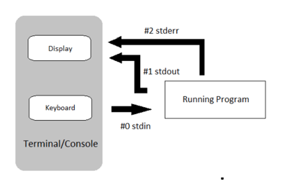
I/O Redirection
Linux programs accept input data from a keyboard and output to a terminal by default. - Data input path is called stdin (standard input) - Data output path is called stdout (standard output)
Redirection is a feature in Linux such that when executing a command, you can change the standard input/output devices.
The basic workflow of any Linux command is that it takes an input and give an output.
The standard input is the keyboard (value:0). The standard output device is the terminal screen (value:1) and standard error (value:2).
www.corvit.com

Slide 27
I/O Redirection
Redirecting input : The < or 0< symbol is used to redirect inputs. $ cat < file cat command would take input from file and list content of file $wc –l < file input file into the word count program to count the number of lines.
Redirecting output: The > or 1> symbol is used to redirect output. $ ls > file write the output of the directory listing to file. $ ls /test >> file append data to file instead of overwriting.
Redirecting Error: The 2> symbol is used to redirect error messages. $ cat 2> errorfile if there is no file named errorfile in the current directory then the error messages are sent to the standard error device.
www.corvit.com

Slide 28
Partitions
There are two kinds of major partitions on a Linux system:
Data Partition: Normal Linux system data, including the root partition containing all the data to start up and run the system.
Swap Partition: Expansion of the computer’s physical memory, extra memory on hard disk.
www.corvit.com
Notes:
https://www.slideshare.net/sicarii_13/disk-and-file-system-management-in-linux

Slide 29
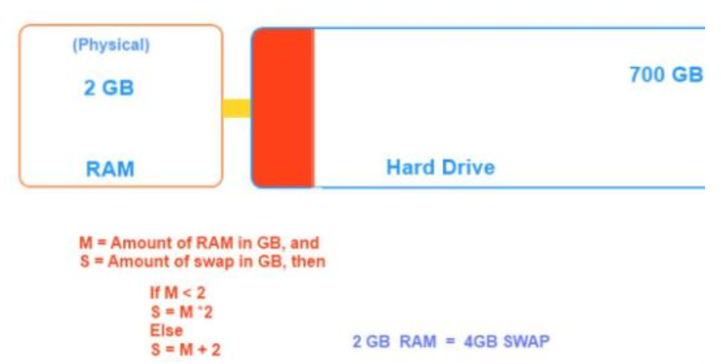
Swap
Swap is a space on a disk that is used when the amount of physical RAM memory is full.
When a Linux system runs out of RAM, inactive pages are moved from the RAM to the swap space.
Swap space can take the form of either a dedicated swap partition or a swap file.
https://www.devopsschool.com/blog/what-is-swap-in-linux-and-useful-commands-to-work-with-swap-space-in-linux/
www.corvit.com

Slide 30
Does Linux use MBR or GPT
For old Linux systems with legacy BIOS, use MBR. Otherwise, stick with GPT.
 | MBR | GPT
Maximum Partition capacity | 2 TB | 9.4 ZB (1 ZB is 1 billion terabytes)
Maximum Partition Number | 4 Primary partitions or 3 primary partitions + an infinite number of logical partitions. | 128 primary partitions
Firmware Interface Support | BIOS | UEFI
Operating System Support | Windows 7 and older systems | New Systems like Windows 10, 8 and new Linux OSes.
www.corvit.com

Slide 31
Partitions
Primary
Extended
Can hold operating system boot files
Cannot be further subdivided into logical drives.
Can be formatted with a file system.
Can be further subdivided into an unlimited number of logical partitions
Cannot be directly formatted with a file system.
However logical partitions within an extended partition can be formatted with a file system.
www.corvit.com
Notes:
https://access.redhat.com/documentation/en-us/red_hat_enterprise_linux/5/html/deployment_guide/ch-lvm https://phoenixnap.com/kb/linux-create-partition https://www.digitalocean.com/community/tutorials/how-to-use-lvm-to-manage-storage-devices-on-ubuntu-18-04

